Slide 1

Gesture Controlled Volume System
Presented by : RAKESH PUNATI
Batch No : 403
INNOMATICS RESEARCH LABS,
DILSUKHNAGAR, HYDERABAD

Slide 2
AGENDA
Introduction
Problem Statement
Problem Objectives
Library Used
System Architecture & Workflow
Key Features & Gesture Logic
Challenges & Constraints
Impact & Future Scope
Conclusion & Acknowledgments
Q&A Slide

Slide 3
INTRODUCTION
Touchless system to control system volume using hand gestures.
Uses Computer Vision & AI-based hand tracking.
Detects thumb and index finger distance.
Converts gesture movement into volume up/down commands.
Real-time webcam-based implementation.

Slide 4
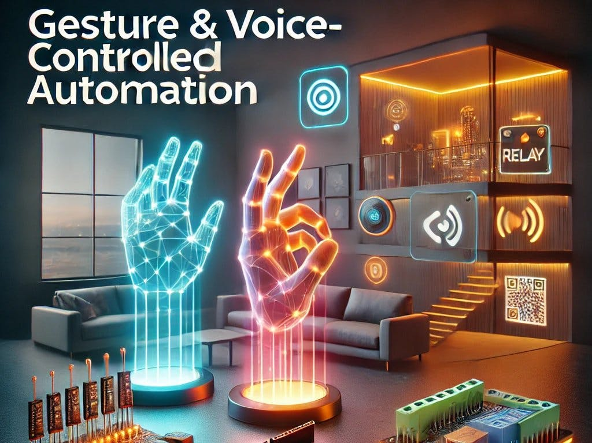
PROBLEM STATEMENT
Traditional volume control requires keyboard/mouse.
Not hygienic or convenient in all environments.
Need for a natural, touch-free human-computer interaction.
Build a real-time gesture-based volume controller

Slide 5
PROBLEM OBJECTIVES
Detect hand landmarks accurately.
Calculate distance between thumb and index finger.
Map finger distance to system volume control.
Ensure smooth & stable real-time performance.
Display FPS and gesture feedback on screen.

Slide 6
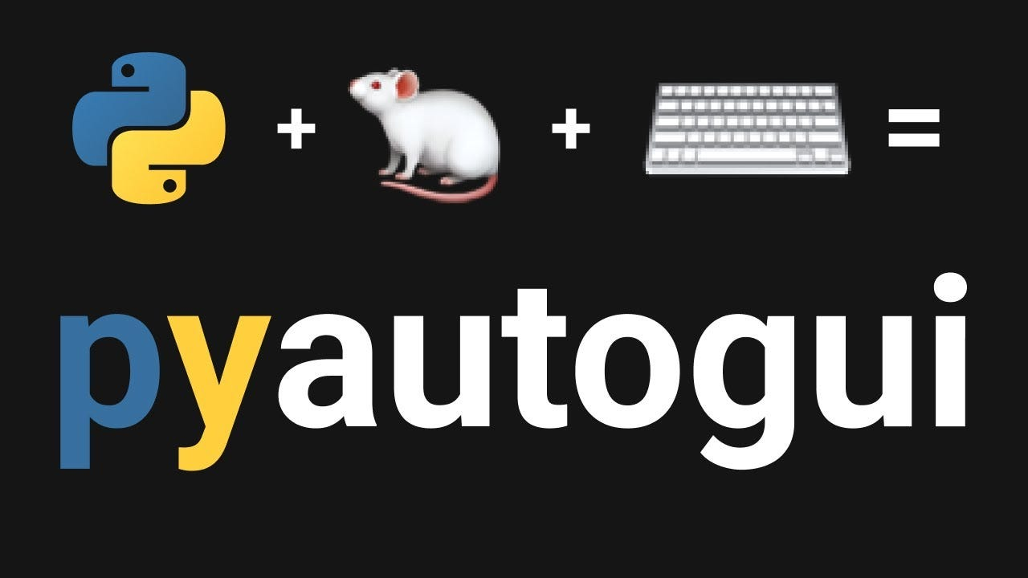
LIBRARY USED
Programming Language: Python
Computer Vision: OpenCV
Hand Tracking: MediaPipe
System Control: PyAutoGUI
Numerical Operations: NumPy

Slide 7
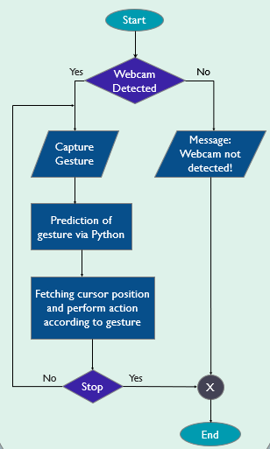
SYSTEM ARCHITECTURE AND WORKFLOW
Webcam captures live video
Frame converted from BGR → RGB
MediaPipe detects hand landmarks
Extract thumb tip & index tip positions
Calculate Euclidean distance
Compare with previous distance
Trigger volume up/down using PyAutoGUI

Slide 8
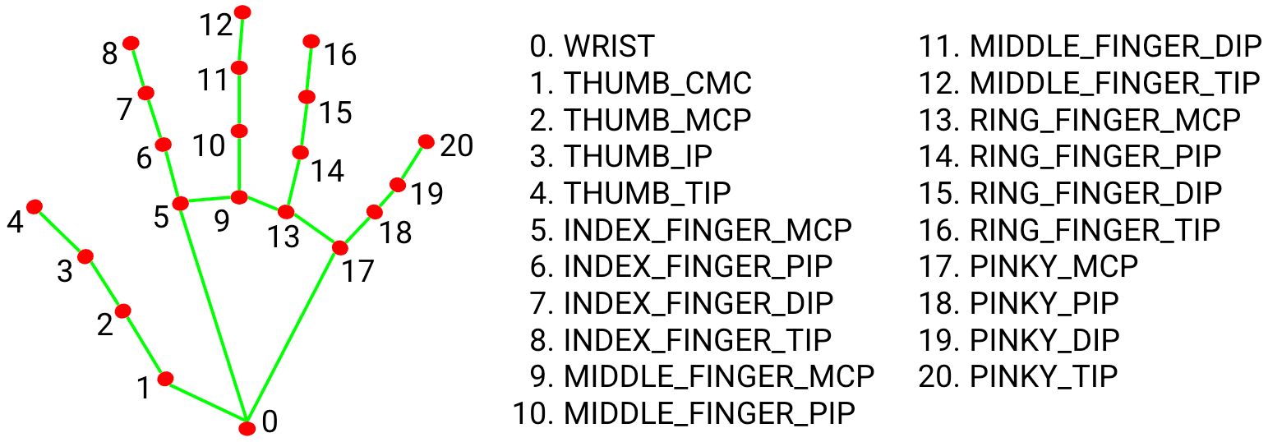

GESTURE LOGIC
Landmark 4 → Thumb tip
Landmark 8 → Index finger tip
Distance formula used:
Small distance → Volume Down
Large distance → Volume Up
Buffer added to reduce shaking noise

Slide 9
KEY FEATURES
Real-time gesture recognition.
FPS counter display.
Visual feedback (circles & lines)Smooth volume transition.
Noise control using threshold buffer.
Lightweight & efficient implementation.

Slide 10
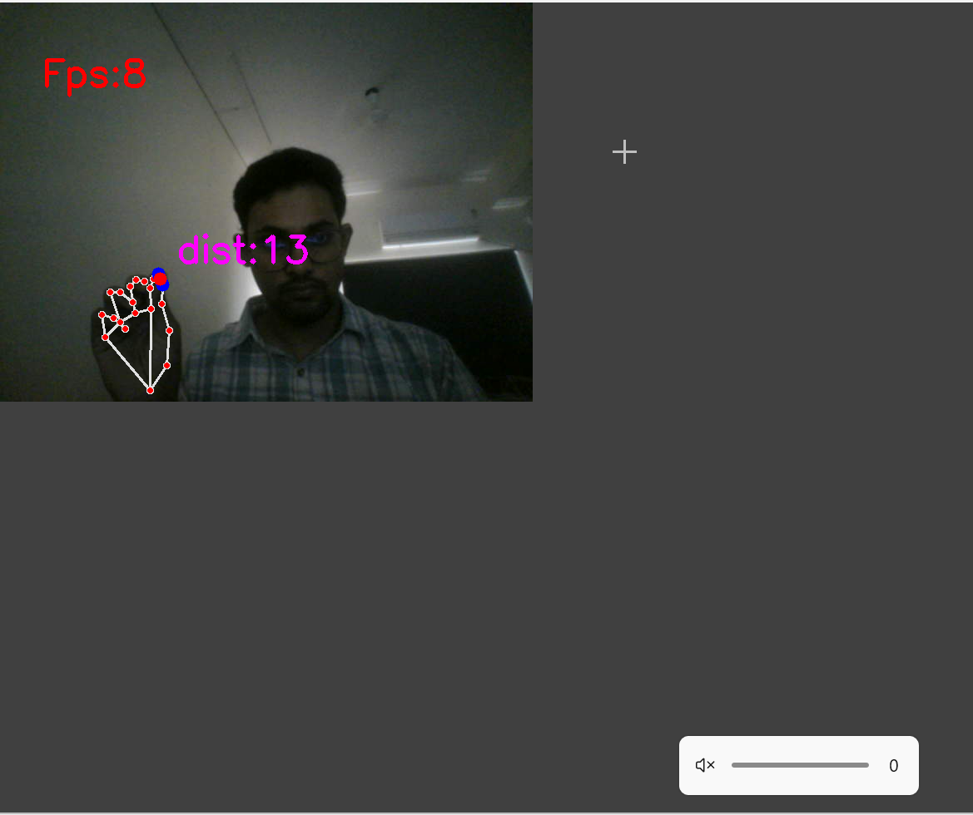
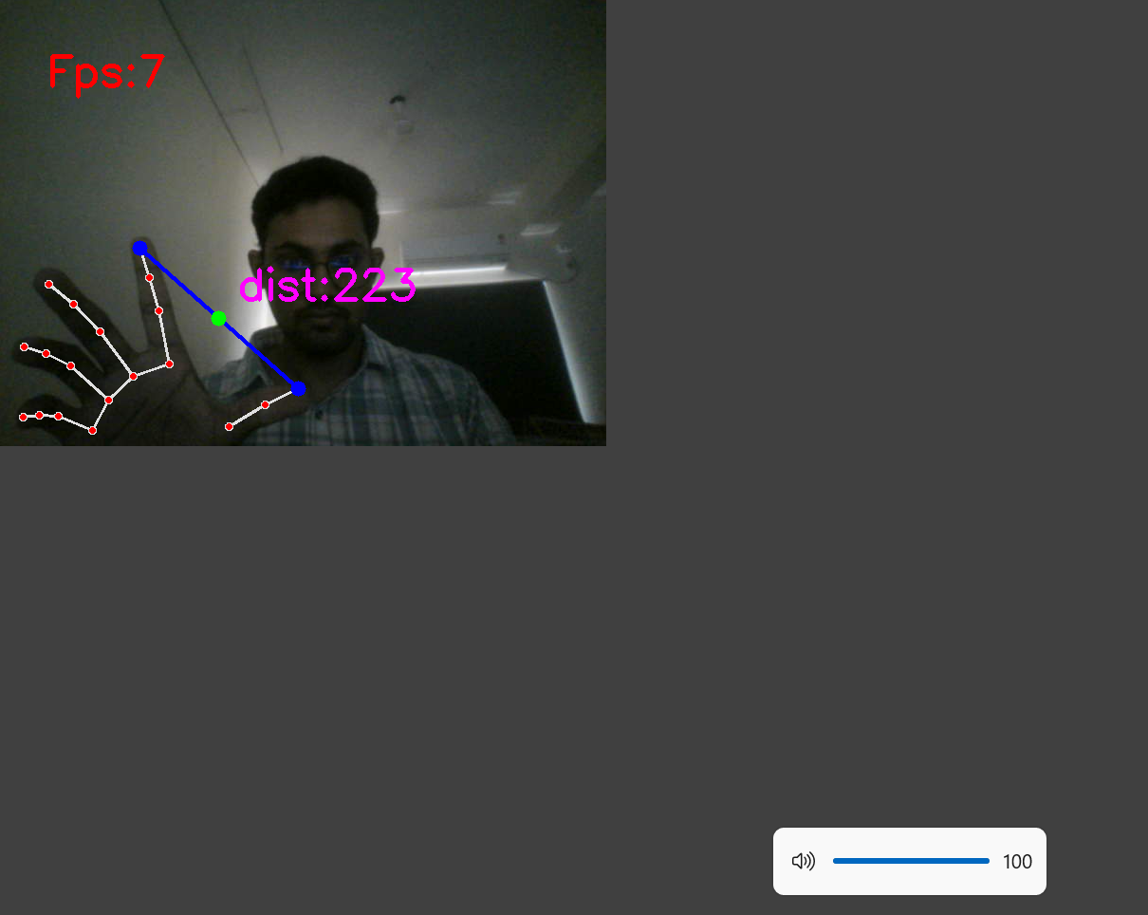
PROJECT OUTPUT

Slide 11
CHALLENGES AND CONSTRAINTS
Sensitive to lighting conditions.
Camera quality affects detection accuracy.
Hand shaking causes unstable control.
Requires proper finger visibility.
FPS drops on low-performance systems

Slide 12
FUTURE SCOPE AND IMPACT
Add brightness control gesture
Control music play/pause
Multi-hand gesture recognition
Integration with IoT devices
Deploy as desktop application

Slide 13
CONCLUSION
Successfully implemented gesture-based volume control
Demonstrates real-time computer vision application
Enhances Human-Computer Interaction
Cost-effective and touchless solution
Can be extended for smart automation systems.

Slide 14

THANK YOU

